Slide 1

Employee Retention Analysis
By Your Name

Slide 2

Objective Overview
Understanding Turnover Reasons
Identify key reasons why employees leave to tackle issues effectively.
Improve Retention Strategies
Use insights to enhance employee loyalty and satisfaction.
Set Benchmark Metrics
Establish measurable outcomes to evaluate retention efforts.
Photos provided by Unsplash

Slide 3
Data Collection Methods
Performance Metrics Review
Analyze existing performance data from Human Resource Department to spot trends related to turnover.

Slide 4

Key Predictive Factors
Job Satisfaction Levels
Higher satisfaction correlates with lower turnover rates; focus on key drivers of job happiness.
Workload
Overwork employee burnout quickly, lead to lower satisfaction
Evaluation and Compensation
Evaluation is highly tied to work hours and may not reflect productivity.
High evaluation do not mean high salary and promotion rate, may also lead to low satisfaction level.
Photos provided by Unsplash

Slide 5
Retention Prediction Model
This table summarizes the various models used to predict employee retention, highlighting their accuracy rates and key metrics employed.
Model Version | Accuracy | Precision | Recall | F1-score | Key Metrics
Logistic Regression | 82% | 47% | 24% | 32%
Decision Tree | 94% | 82% | 85% | 84% | Work hours, evaluation, years employed, salary
Random Forest | 95% | 80% | 91% | 86% | Work hours, evaluation, years employed, salary

Slide 6
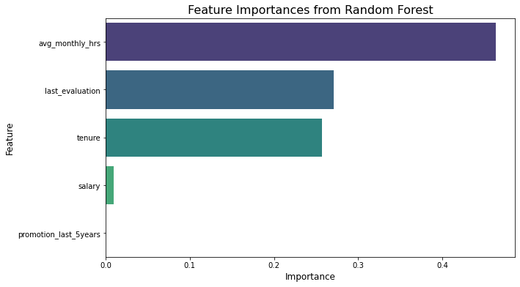
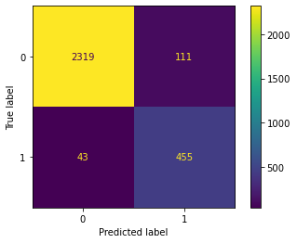
Retention Prediction Model Visualization
Confusion Matrix of the Prediction

Slide 7
Conclusion and Recommendations
Summary of Key Findings
Recommendations
Overwork is prevalent(>170 hours/month)
Employee start mass exodus from year 3 and peak at year 5
Employee who leave concentrated in two group, one is high work hour, high evaluation, and the other is low work hour low evaluation
Salary and promotion rate are low among high work hour, high evaluation employee
Evaluation is highly correlated with workload
Restrict overtime work to reduce burnout, make employee and management aware of the company’s overtime policy.
Improve the evaluation system, make it less tied to work hours, but more on productivity.
Improve the compensation among high performance employee.

Slide 8
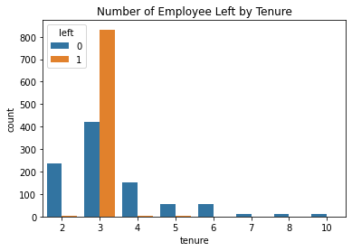
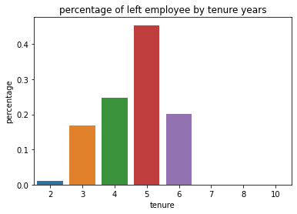
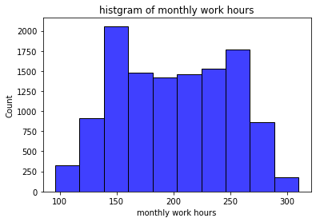
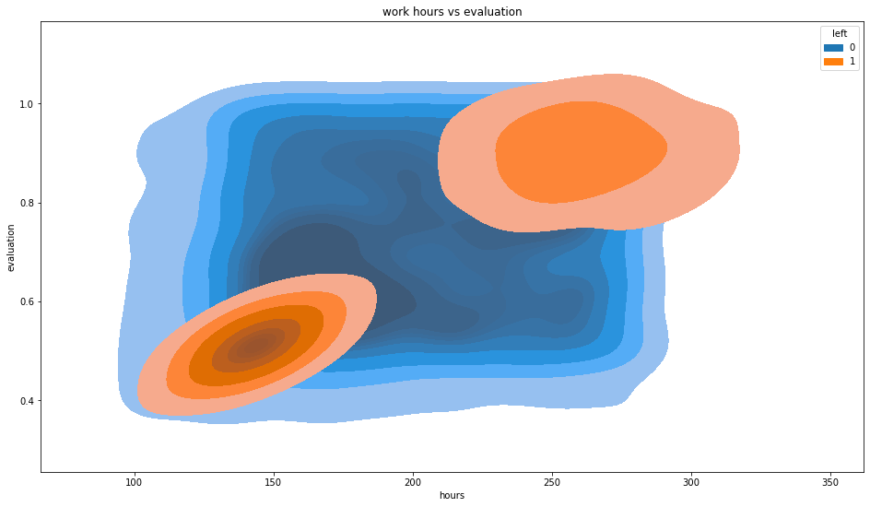
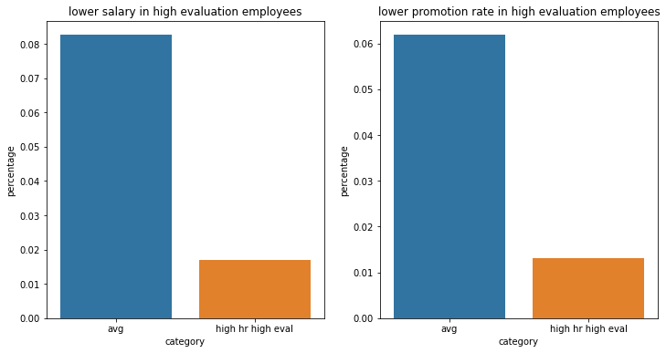

Slide 9
